Slide 1
Term Level Search Result Diversification
Date : 2013/09/11
Source : SIGIR’13
Authors : Van Dang, W. Bruce Croft
Advisor : Dr.Jia-ling, Koh
Speaker : Shun-Chen, Cheng

Slide 2
Outline
Introduction
Topic Level Diversification
Term Level Diversification
Experiment
Conclusions

Slide 3
Introduction
Diversification
to produce a more diverse ranked list with respect to some set of topics or aspects associated with this query.

Slide 4
Introduction
Goal:
whether diversification with respect to these topics benefits from the additional structure or grouping of terms or would diversification using the topic terms directly be just as effective?

Slide 5
Outline
Introduction
Topic Level Diversification
Term Level Diversification
Experiment
Conclusions

Slide 6
Topic Level Diversification
D1
D2
D3
D4
D5
D6
D7
D8
....
P(d1|t1)
T1 : w1
T2 : w2
T3 : w3
.
.
.
.
.
tn : wn
D1
D3
D4
D8
P(d1|tn)
Search result list
Topic set
Select subset of size k
Diversity by Redundancy : xQuAD
Diversity by Proportionality : PM-2

Slide 7
Ex of xQuAD:
S=Ø ,λ=0.6
1st iteration
2nd iteration
d1 | T1 | 0.3
0.9 | t2 | 0.2
D1=0.4*0.9+0.6[0.8*0.3*1+0.2*0.2*1]
=0.36+0.6[0.24+0.04]
D2=0.4*0.8+0.6[0.8*0.3*(1-0.3)+0.2*0.1*(1-0.2)]
=0.32+0.6[0.24*0.7+0.02*0.8]=0.4304
D2=0.4*0.8+0.6[0.8*0.3*1+0.2*0.1*1]
=0.32+0.6[0.24+0.02]
d2 | T1 | 0.3
0.8 | t2 | 0.1
D3=0.4*0.7+0.6[0.8*0.1*0.7+0.2*0.3*0.8]
=0.28+0.6[0.08*0.7+0.06*0.8]=0.3424
D3=0.4*0.7+0.6[0.8*0.1*1+0.2*0.3*1]
=0.28+0.6[0.08+0.06]
d3 | T1 | 0.1
0.7 | t2 | 0.3
D4=0.4*0.5+0.6[0.8*0.2*0.7+0.2*0.1*0.8]
=0.2+0.6[0.16*0.7+0.02*0.8]=0.2768
D4=0.4*0.5+0.6[0.8*0.2*1+0.2*0.1*1]
=0.2+0.6[0.16+0.02]
d4 | T1 | 0.2
0.5 | t2 | 0.1
D5=0.4*0.2+0.6[0.8*0.1*0.7+0.2*0.3*0.8]
=0.08+0.6[0.08*0.7+0.06*0.8]=0.1424
D5=0.4*0.2+0.6[0.8*0.1*1+0.2*0.3*1]
=0.08+0.6[0.08+0.06]
d5 | T1 | 0.1
0.2 | t2 | 0.3
S={d1,d2}
S={d1}
W1 | 0.8
w2 | 0.2

Slide 8
d1 | T1 | 0.3
0.9 | t2 | 0.2
d2 | T1 | 0.3
0.8 | t2 | 0.1
d3 | T1 | 0.1
0.7 | t2 | 0.3
d4 | T1 | 0.2
0.5 | t2 | 0.1
d5 | T1 | 0.1
0.2 | t2 | 0.3
W1 | 0.8
w2 | 0.2
3rd iteration
4th iteration
D3=0.28+0.6[0.08*0.7*0.7+0.06*0.8*0.9]
=0.28+0.6[0.08*0.49+0.06*0.72]=0.32944
D4=0.2+0.6[0.16*0.7*0.7*0.9+0.02*0.8*0.9*0.7]
=0.2+0.6[0.16*0.441+0.02*0.504]=0.248384
D4=0.2+0.6[0.16*0.7*0.7+0.02*0.8*0.9]
=0.2+0.6[0.16*0.49+0.02*0.72]=0.25568
D5=0.08 +0.6[0.08*0.7*0.7*0.9+0.06*0.8*0.9*0.7]
=0.08+0.6[0.08*0.441+0.06*0.504]=0.119312
D5=0.08 +0.6[0.08*0.7*0.7+0.06*0.8*0.9]
=0.08+0.6[0.08*0.49+0.06*0.72]=0.12944
S={d1,d2,d3,d4}
S={d1,d2,d3}

Slide 9
Ex of PM-2
For 3rd position
s1=1.35,s2=0.65
For 1st position
s1=0,s2=0
For 2nd position
qt[1] = 0.217
s1=0.6,s2=0.4
qt[2] = 0.087
d1 | T1 | 0.3
 | t2 | 0.2
qt[1] = w1/(2*0+1)=0.8
qt[1] = 0.8/(2*0.6+1)=0.36
qt[2] = w2/(2*0+1)=0.2
D3= 0.6*0.217*0.1+0.4[0.087*0.3]
=0.02346
qt[2] = 0.2/(2*0.4+1)=0.11
d2 | T1 | 0.3
 | t2 | 0.1
D1= 0.6*0.8*0.3+0.4[0.2*0.2]
=0.144+0.016=0.16
D2= 0.6*0.36*0.3+0.4[0.11*0.1]
=0.0648+0.0044=0.0692
D4= 0.6*0.217*0.2+0.4[0.087*0.1]
=0.02952
D2= 0.6*0.8*0.3+0.4[0.2*0.1]
=0.144+0.008=0.152
D3= 0.6*0.36*0.1+0.4[0.11*0.3]
=0.0216+0.0132=0.0348
d3 | T1 | 0.1
 | t2 | 0.3
D5= 0.6*0.217*0.1+0.4[0.087*0.3]
=0.02346
D3= 0.6*0.8*0.1+0.4[0.2*0.3]
=0.048+0.024=0.072
D4= 0.6*0.36*0.2+0.4[0.11*0.1]
=0.0432+0.0044=0.0476
S1=1.35+(0.2/(0.2+0.1))=2.01
S2=0.65+(0.1/(0.2+0.1))=0.98
d4 | T1 | 0.2
 | t2 | 0.1
D4= 0.6*0.8*0.2+0.4[0.2*0.1]
=0.096+0.008=0.0104
D5= 0.6*0.36*0.1+0.4[0.11*0.3]
=0.0216+0.0132=0.0348
For 4th position
D5= 0.6*0.8*0.1+0.4[0.2*0.3]
=0.048+0.024=0.072
qt[1] = 0.159
qt[2] = 0.068
d5 | T1 | 0.1
 | t2 | 0.3
S1=0.6+(0.3/(0.3+0.1))=1.35
S2=0.4+(0.1/(0.3+0.1))=0.65
D3= 0.6*0.159*0.1+0.4[0.068*0.3]
=0.0177
S1=0+(0.3/(0.3+0.2))=0.6
S2=0+(0.2/(0.3+0.2))=0.4
D5= 0.6*0.159*0.1+0.4[0.068*0.3]
=0.0177
W1 | 0.8
w2 | 0.2

Slide 10
Outline
Introduction
Topic Level Diversification
Term Level Diversification
Experiment
Conclusions

Slide 11
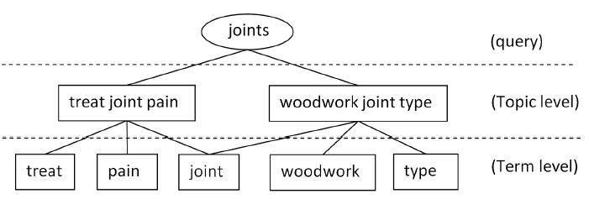
Term Level Diversification
More relevant
More relevant
based on the assumption that if a document is more relevant to one topic than another, it is also more relevant to the terms associated with this topic than any of the terms from the other topic.

Slide 12
Term Level Diversification
Instead of diversifying R using the set of topics T , we propose to perform diversification using T′ , treating each as a topic.
Ex: Topic level： t = { treat joint pain ，woodwork joint type}
Term level： T’ = {treat，joint，pain，woodwork，type}

Slide 13
Term Level Diversification

Slide 14
Term Level Diversification
Vocabulary(V) Identification:
1. appear in at least two documents
2. at least two characters
3. not numbers
two types of terms: unigrams and phrases
Topic Terms(T) Identification:
All vocabulary terms that co-occur with any of the query terms within a proximity window of size w

Slide 15
Term Level Diversification
Topicality and Predictiveness:
topicality: how informative it is at describing the set of documents
Predictiveness: how much the occurrence of a term predicts the occurrences of others

Slide 16
Ex of DSP Algo.
P(t1|q) | 0.1
P(t2|q) | 0.7
P(t3|q) | 0.2
Pc(t1) | 0.1
Pc(t2) | 0.6
Pc(t3) | 0.3
Q={}
V={v1,v3,v4,v6,v7,v9}
T={v2,v5,v8}
Ct1={v1,v3,v4,v7,v9}
Ct2={v4,v7,v9}
Ct3={v6}
1st iteration
DTT=Ø ， PRED=Ø
Pw(t1|v1) | 0.1
Pw(t1|v3) | 0.5
Pw(t1|v4) | 0.2
Pw(t1|v7) | 0.8
Pw(t1|v9) | 0.1
TP(t1)= 0.1log(0.1/0.1)
= 0
PR(t1)=(1/5)*(0.1+0.5+0.2+0.8+0.1)
=0.2*1.7=0.34
=> TP(1)*PR(t1)=0
DTT={t2}
pred={v4,v7,v9}
Update PR(ti):
TP(t2)=0.7log(0.7/0.6)
= 0.047
PR(t2)=(1/3)*(0.7+0.5+0.9)
=0.33*2.1=0.693
=> 0.047*0.693= 0.032571
PR(t1)= 0.34 -Pw(t1|v4)-Pw(t1|v7) -Pw(t1|v9)
=0.34 - 0.2 - 0.8 - 0.1
= -0.76
Pw(t2|v4) | 0.7
Pw(t2|v7) | 0.5
Pw(t2|v9) | 0.9
PR(t3)= 0.6 -Pw(t3|v4)-Pw(t3|v7)-Pw(t3|v9)
=0.6 - 0
TP(t3)=0.2log(0.2/0.3)
= -0.035
PR(t3)=1*0.6=0.6
=>-0.035*0.6= - 0.021
Pw(t3|v6) | 0.6
PRED={v4,v7,v9}
=> t*=t1

Slide 17
2nd iteration
DTT={t1,t2}
PRED={v4,v7,v9}
TP(t1)= 0.1log(0.1/0.1)
= 0
PR(t1)= - 0.76
=> TP(t1)*PR(t1)=0
Pw(t1|v1) | 0.1
Pw(t1|v3) | 0.5
Pw(t1|v4) | 0.2
Pw(t1|v7) | 0.8
Pw(t1|v9) | 0.1
pred={v1,v3,v4,v7,v9}
Update PR(ti):
TP(t3)=0.2log(0.2/0.3)
= -0.035
PR(t3)= 0.6
=>TP(t3)*PR(t3)= -0.021
PR(t3)= 0.6 -Pw(t3|v1)-Pw(t3|v1)
=0.6
Pw(t2|v4) | 0.7
Pw(t2|v7) | 0.5
Pw(t2|v9) | 0.9
PRED={v1,v3,v4,v7,v9}
=> t*=t1
3rd iteration
Pw(t3|v6) | 0.6
DTT={t1,t2,t3}

Slide 18
Outline
Introduction
Topic Level Diversification
Term Level Diversification
Experiment
Conclusions

Slide 19
Experiments
Experimental setup:
Query set:
147 queries with relevance judgments from three years of the TRECWeb Track’s diversity task(2009,2010,2011)
Retrieval Collection:
ClueWeb09 Category B retrieval collection
Evaluation Metric
diversity tasks : α-NDCG、ERR-IA、NRBP、Precision-IA、subtopic recall
relevance-based : NDCG、ERR
evaluated at the top 20 documents.
Parameter Settings
K = 50，topic and term extraction techniques operate on these top 50 documents.

Slide 20
Experiments
Q: statistically significant differences to QL
W/L : with respect to α-NDCG
This suggests that existing diversification frameworks are capable of returning relevant documents for topics without the explicit topical grouping

Slide 21
Experiments
Q, M, L, K : statistically significant differences to QL, MMR, LDA and KNN respectively.
Bold face : the best performance in each group.
Unigrams : improving more queries and hurting fewer
Phrases : retrieve more relevant results
DSPApprox has slightly lower subtopic recall compared to query-likelihood (QL), the difference is not significant. (97% overlap).

Slide 22
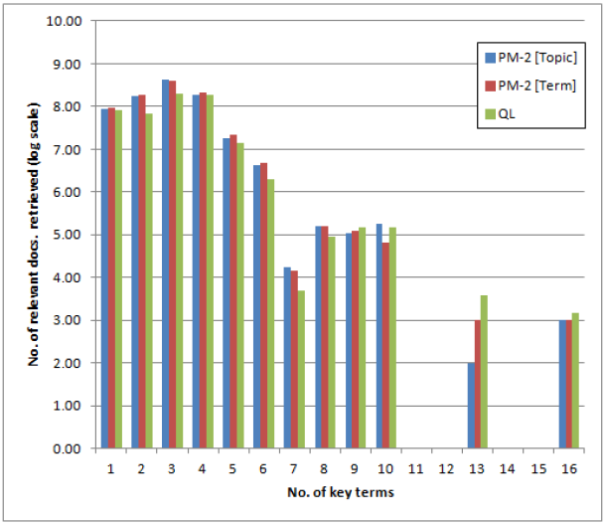
Experiments

Slide 23
Conclusions
Introduces a new approach to topical diversification: diversification at the term level.
Existing work models a set of aspects for a query, where each aspect is a coherent group of terms. Instead, we propose to model the topic terms directly.
Experiments indicate that the topical grouping provides little benefit to diversification compared to the presence of the terms themselves.
Effectively reduces the task of finding a set of query topics, which has proven difficult, into finding a simple set of terms.

